Slide 1

Welcome To Class !!!
Computer Organization and Assembly Language
About Me !

Slide 2

Pre-Requisite :
Computer Organization and Assembly language
Digital logic design CS-430
References for Pre-requisite course:
M. Morris Mano, Michael D. Ciletti, “Digital design”, 4th edition, 2008
Any Programming Language Background
Notes:
ra

Slide 3
Course Organization: Outline
Introduction.
Historical background of Processors.
Computer Organization concepts.
Instruction Set Architect (ISA).
Addressing modes.
Memory basics and Type of memories.
Memory Modeling.
Cache Memory design.
Pipelining concepts.
Interrupts.
I/O concepts.
Assembly language programming.
Semester Project
Detailed outline could be provided on group.

Slide 4
Course Organization: Literature
Course Books:
Computer Organization & Architecture, 9th Edition, William Stallings. 2012
The Intel Microprocessors 8086/8088, 80186/188, 80286, 80386, 80486, Pentium processors By Barry.B.Brey
Assembly Language for x86 Processors, 6th Edition, Kip R. Irvin,
Class Notes and slides are important

Slide 5
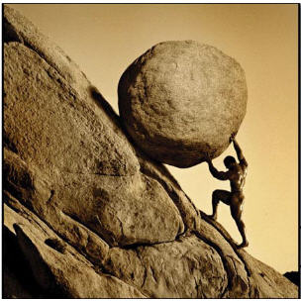
Course Organization: Course Load
Lectures + Labs:
You must attend them.
In-Lecture Quizzes: (Non-graded)
To encourage class participation.
Reading Exercises/Tutorials:
Communicated in class and shared on group.
Quizzes/assignments:
Announced + Unannounced
Design Project:
You must make a design project till end of course.
Mid / Final Exam:
Discussion Topic:

Slide 6

Course Organization : Policies
Policies:
Assignments:
Class assignments will be provided rather than take away home.
Don't miss assignments as they are highly weighted source of learning.
Rules for assignment submissions are very Clear !!! (100% your own work for credits)
Quizzes:
Most of the Quizzes will be unannounced except few.
Mid Term / Final Exam :
Practical:
Lab Simulation
Term Project / demo presentation …
Final practical exam

Slide 7

Attendance Policy :
Attendance:
70% Univ. Requirement

Slide 8
Course Organization : Grading Policy
Internals and Practical marks are important but hard to earn.
Evaluation | Marks Distribution
Assignment + Quizzes | 12 ( Internals )
Mid Term | 18
Final Exam | 30
Practical | (Project+Written Exam)
Total | 80

Slide 9
Course Organization:Correspondance
Group : coa4A google classroom/gmail/yahoo
Helpful and mandatory for course.
All softcopies will be uploaded here.
Reading + tutorial Materials.
Correspondence:
Extra Time : After Lecture.
Email : Any time prompt reply (I.A)
Class Timings: ???
Class Rep.

Slide 10

What not to do !!!
No tolerance on Cross talk in class !!!
People leaving in between class just to attend phone call.
Habitual late comers just for attendance.
Students asking for unfair grades

Slide 11

Your Feedback !!!
Quick Introduction.
Suggestions for improvement.
Anything you want to see in the course ?

Slide 12
Pre-Req. : Quick Revision
Pre-Req. : Digital Logic Design

Slide 13

Continuous Vs Discrete:
Continuous-Time Signals:
Quantities that are defined for all values of time.
Speech signal, Voltage signal, Sensor output
Waveform:
Analog Signals are Continuous time signals …

Slide 14

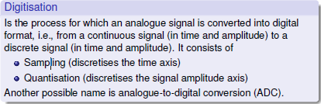
Continuous Vs Discrete:
Discrete Time Signal:
Exists for discrete time instants only.
Not defined for all values.
Obtained by sampling of continuous time signals.

Slide 15
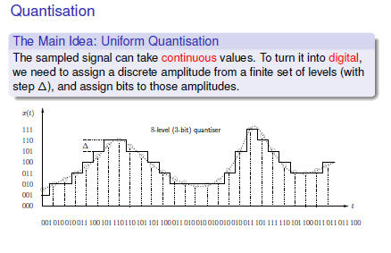
Digital Signals:
Staircase approximation of discrete signals are digital signals.
Digital Signal

Slide 16
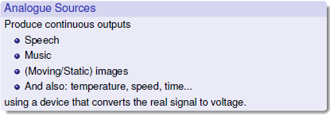
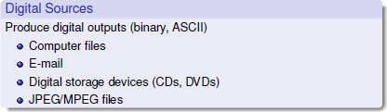
Analog and Digital:

Slide 17
Digital Number Systems:
As told earlier, digital systems can process discrete set of information, based upon which we have …
Digital Number System:
Binary
Octal
Decimal
Hexadecimal
Digital Computers are based upon Binary Number System and course primarily revolves around it.
BIT: Smallest unit of digital information. Contraction of word Binary Digit.
Hexadecimal
Decimal
Binary
Octal

Slide 18
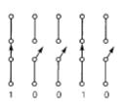
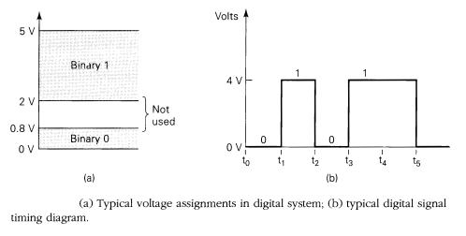
Number System : Binary
Binary system consists of 2 alphabets/symbols/values i.e Zero (0) & One(1).
Base-2 system , suitable for digital computers.
Why binary?
Hardware perspective : a transistor circuit is either ON or OFF (two stable states).
Easy to implement in software.
Simple and accurate circuit design
Representation of Binary Quantities:

Slide 19
Base Systems :
In order to represent numbers of different bases, we surround a number
in parenthesis and then place a subscript with the base of the number.
A decimal number (9233)₁₀
A binary number (11011)₂
A hexadecimal number (30FA)₁₆
An octal number (6107)₈

Slide 20
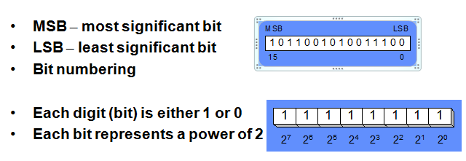
Binary Representation :
Bit :
Nibble : 4 bits
Byte : 8 bits
Word : 16 bits
Double word : 32 bits

Slide 21
Base-r to Decimal Conversion :
Weighting factor scaling is required according to that specific base system.
Weights are (base-system)^ ^{position_value}
Rules are same for
Binary to decimal
Octal to decimal
Hexadecimal to decimal
Evaluate magnitude or weighting factor.
Multiply number by its weight.
Special treatment for fractional parts.

Slide 22
Binary to Decimal Conversion :
The binary system uses powers of 2 as the multipliers for the coefficients.
For example:
(1011)₂ =
1x2³ + 0x2² ⁺ 1x2¹ ⁺ 1x2⁰ = (11)₁₀
What about fractions?
(110.10)2 = 1x2² + 1x2¹ + 0x2⁰ + 1x2⁻¹ + 0x2⁻² = (6.5)₁₀
we can represent the binary number 10111.01 as:
= 1 X 2⁴ + 0 X 2³ + 1 X 2² + 1 X 2¹ + 1 X 2⁰ + 0 X 2⁻¹ + 1 X 2⁻² = =(23.25)₁₀
See binary Weighting table as a reference ….

Slide 23
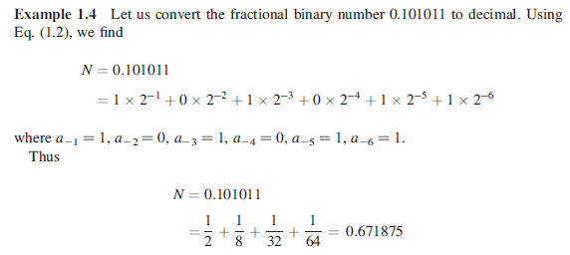
More Examples : Handling fractions
How to handle binary point :

Slide 24
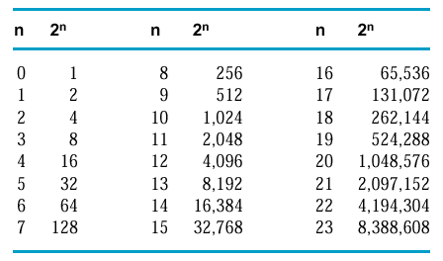
Weighting Table for Binary :
Caution : 1K in binary is not 1000 instead its 1024.
2¹⁰ is referred to as Kilo, called "K"
2²⁰ is referred to as Mega, called "M"
2³⁰ is referred to as Giga, called "G"

Slide 25
Octal to Decimal Conversion:
The octal number system is a base-8 system that contains the coefficient values of 0 to 7.
The octal system uses powers of 8 as the multipliers for the coefficients.
Weights are (base-system)^ ^{position_value}
For example:
Convert octal number 72032 to decimal:
7 X 8⁴ + 2 X 8³ + 0 X 8² + 3 X 8¹ + 2 X 8⁰
= (29722)₁₀

Slide 26
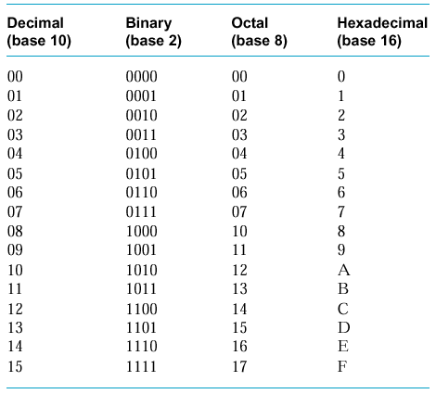
Hexadecimal System :

Slide 27
Hexadecimal to Decimal Conversion :
The hexadecimal number system is a base-16 system that contains the coefficient values of 0 to 9 and A to F. The letters A through F represent the coefficient values of 10, 11, 12, 13, 14, and 15, respectively.
The hexadecimal system uses powers of 16 as the multipliers for the coefficients.
For example:
Convert hexadecimal number C34D to decimal :
= 12 X 16³ + 3 X 16² + 4 X 16¹ + 13 X 16⁰
= (49997)₁₀

Slide 28
Decimal to Base-r Conversion :
The conversion of a decimal integer into a number in base-r is done by dividing the number and all successive quotients by r and accumulating the remainders in reverse order of computation.
Decimal to Binary :
Decimal to Octal :
Decimal to Hexadecimal :

Slide 29
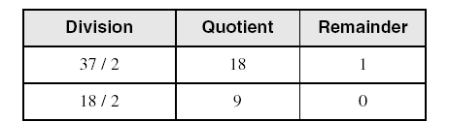
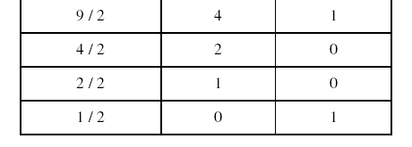
Decimal to Binary :
Convert (37)₁₀ to binary
(37)₁₀ = 100101

Slide 30
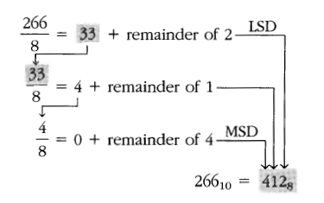
Decimal to Octal :

Slide 31
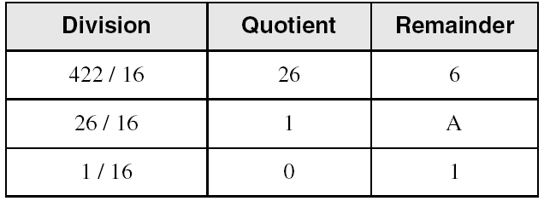
Decimal to hexadecimal :
The conversion of a decimal integer into hexadecimal is done by dividing the number and all successive quotients by 16 and accumulating the remainders in reverse order of computation.
(422)₁₀ = (1A6)₁₆

Slide 32
Mixed Conversions :
Binary to Octal:
Group the binary digits into three bit groups starting at the radix point and going both ways, padding with zeros as needed.
Convert each group of three bits to an equivalent octal digit.
Octal to Binary:
It is done by reversing the preceding procedure
Restate the octal as three binary digits
Start at the radix point and go both ways, padding with zeros as needed.

Slide 33
Mixed Conversions : Examples
Convert (10110001101011.11110000011)₂ to Octal
= 010 110 001 101 011 . 111 100 000 110
= 2 6 1 5 3 . 7 4 0 6
= (26153.7406)₈
Convert (673.124)₈ to binary
= 110 111 011 . 001 010 100
= (110111011.001010100)₂
Convert (11010100011011) ₂ to Octal

Slide 34
Mixed Conversions :
Binary to Hexadecimal:
Group the binary digits into four bit groups starting at the radix point and going both ways, padding with zeros as needed (at the ends)
Convert each group of four bits to an equivalent hexadecimal digit
Hexadecimal to Binary:
It is done by reversing the preceding procedure
Restate the hexadecimal as four binary digits
Start at the radix point and go both ways, padding with zeros as needed

Slide 35
Mixed Conversions : Examples
Convert(10110001101011.11110010)₂to hexadecimal
= 0010 1100 0110 1011 . 1111 0010
= 2 C 6 B . F 2
= (2C6B.F2)₁₆
Convert (306.D)₁₆ to binary
= 0011 0000 0110. 1101
= (001100000110.1101)₂
Convert (11010100011011) ₂ to hexadecimal

Slide 36
Binary Addition
Column Addition
1
1
1
1
1
1
1
1
1
1
0
1
= 61
= 23
+
1
0
1
1
1
1
0
1
0
1
0
0
= 84
≥ (2)₁₀

Slide 37
Binary Adder : Half adder
Half Adder
Adds 1-bit plus 1-bit
Produces Sum and Carry
x
+ y
───
C S
x y | C S
0 0 | 0 0
0 1 | 0 1
1 0 | 0 1
1 1 | 1 0
x
y
S
C

Slide 38
Binary Adder : Full adder
Full Adder
Adds 1-bit plus 1-bit plus 1-bit
Produces Sum and Carry
x
+ y
+ z
───
C S
x y z | C S
0 0 0 | 0 0
0 0 1 | 0 1
0 1 0 | 0 1
0 1 1 | 1 0
1 0 0 | 0 1
1 0 1 | 1 0
1 1 0 | 1 0
1 1 1 | 1 1
S = xy'z'+x'yz'+x'y'z+xyz = x ⊕ y ⊕ z
C = xy + xz + yz

Slide 39
Binary Adder :
Full Adder
S = xy'z'+x'yz'+x'y'z+xyz = x ⊕ y ⊕ z
x
y
z
C = xy + xz + yz
S
C
S
C
x
y
z

Slide 40
Binary Adder : Carry Propagate adder
x₃x₂x₁x₀ y₃y₂y₁y₀
c₃ c₂ c₁ .
+ x₃ x₂ x₁ x₀
+ y₃ y₂ y₁ y₀
────────
Cy S₃ S₂ S₁ S₀
Binary Adder
Carry Propagate Addition
C_{y}
C₀
S₃S₂S₁S₀
x₃ x₂ x₁ x₀
y₃ y₂ y₁ y₀
0
FA
FA
FA
FA
C₄ C₃ C₂ C₁
S₃ S₂ S₁ S₀

Slide 41
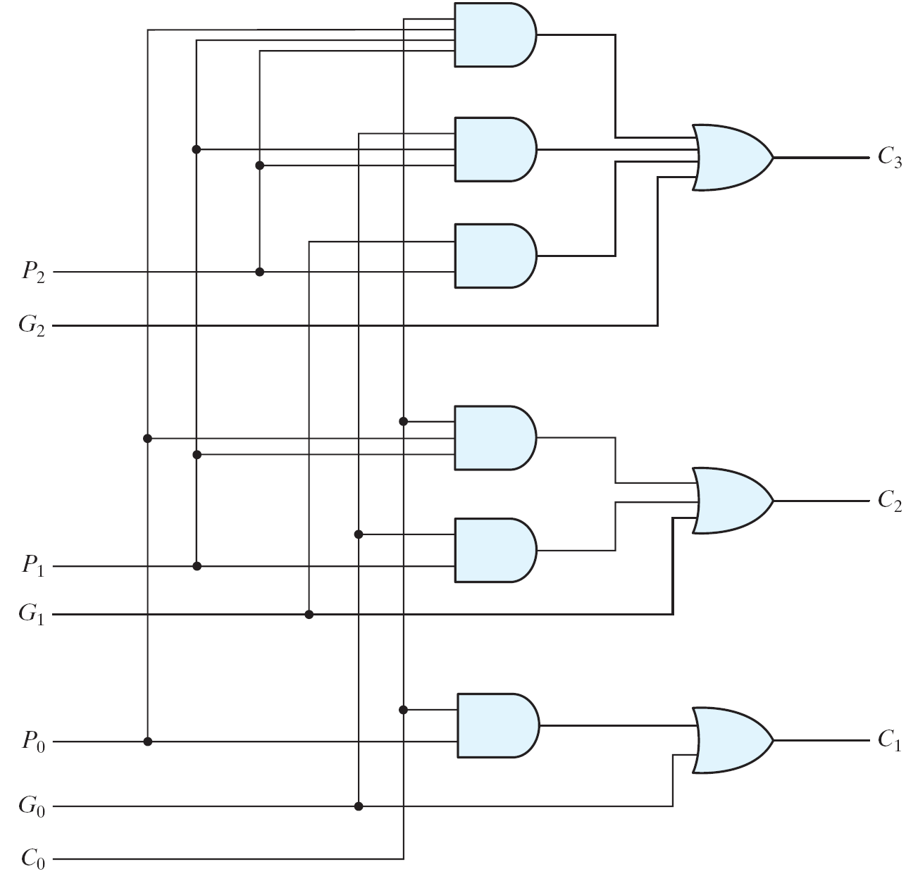
Carry Look-ahead Adder (1/2)
Fig. 4.11 Logic Diagram of Carry Look-ahead Generator
Logic diagram

Slide 42
Complements
Complements are used to simplify subtraction operations. We do subtraction by adding.
A – B = A+ (-B)
There are two types:
The radix complement, called the r’s complement.
The diminished radix complement, called the (r-1)’s complement.
Benefits ???
Hardware Simplification : Same hardware is used for Addition and Subtraction operation

Slide 43
DRC : Procedure
1’s complement:
The DRC (1’s complement) of a binary number is obtained by subtracting each digit from 1. It can also be formed by changing 1’s to 0’s and 0’s to 1’s

Slide 44
DRC Examples : 1’s complement
To determine the 1’s complement of 1000101:
To determine the 1’s complement of 11110111101:

Slide 45
Practice Examples :
1’s Complement (Diminished Radix Complement)
All ‘0’s become ‘1’s
All ‘1’s become ‘0’s
Example
Given a number (10110000)₂ ,Find its 1’s complement
(01001111)₂

Slide 46
Radix Complements : The Shortcuts …
Shortcut # 1:
Radix complement is obtained by adding 1 to DRC.To find 2’s complement,we add 1 to 1’s complement value .
2’s complement of 101101 is:
Shortcut # 2:
Note that to determine 2’s complement, leave the least significant 0’s and the first 1 unchanged and then switch the remaining 1’s to 0’ and 0’s to 1’s.
Apply in above example …

Slide 47
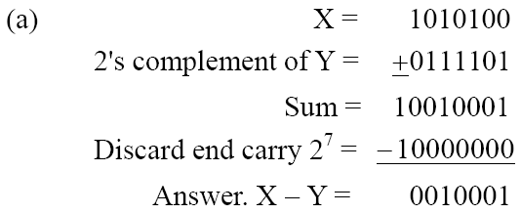
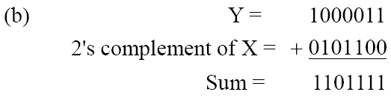
Binary Subtraction : 2's complement
Examples:
Given the two binary numbers X = 1010100 and Y = 1000011, perform the subtraction (a) X – Y ; and (b) Y − X, by using 2's complement.
There is no end carry. Therefore, the answer is Y – X = − (2's complement of 1101111) = − 0010001.

Slide 48
Binary Subtractor :
Use 2’s complement with binary adder
x – y = x + (-y) = x + y’ + 1

Slide 49
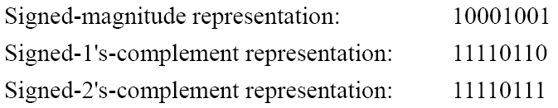
Signed Numbers:
To represent negative integers, we need a notation for negative values.
It is customary to represent the sign with a bit placed in the leftmost position of the number since binary digits.
The convention is to make the sign bit 0 for positive and 1 for negative.
Example:
Table lists all possible four-bit signed binary numbers in the three representations.

Slide 50
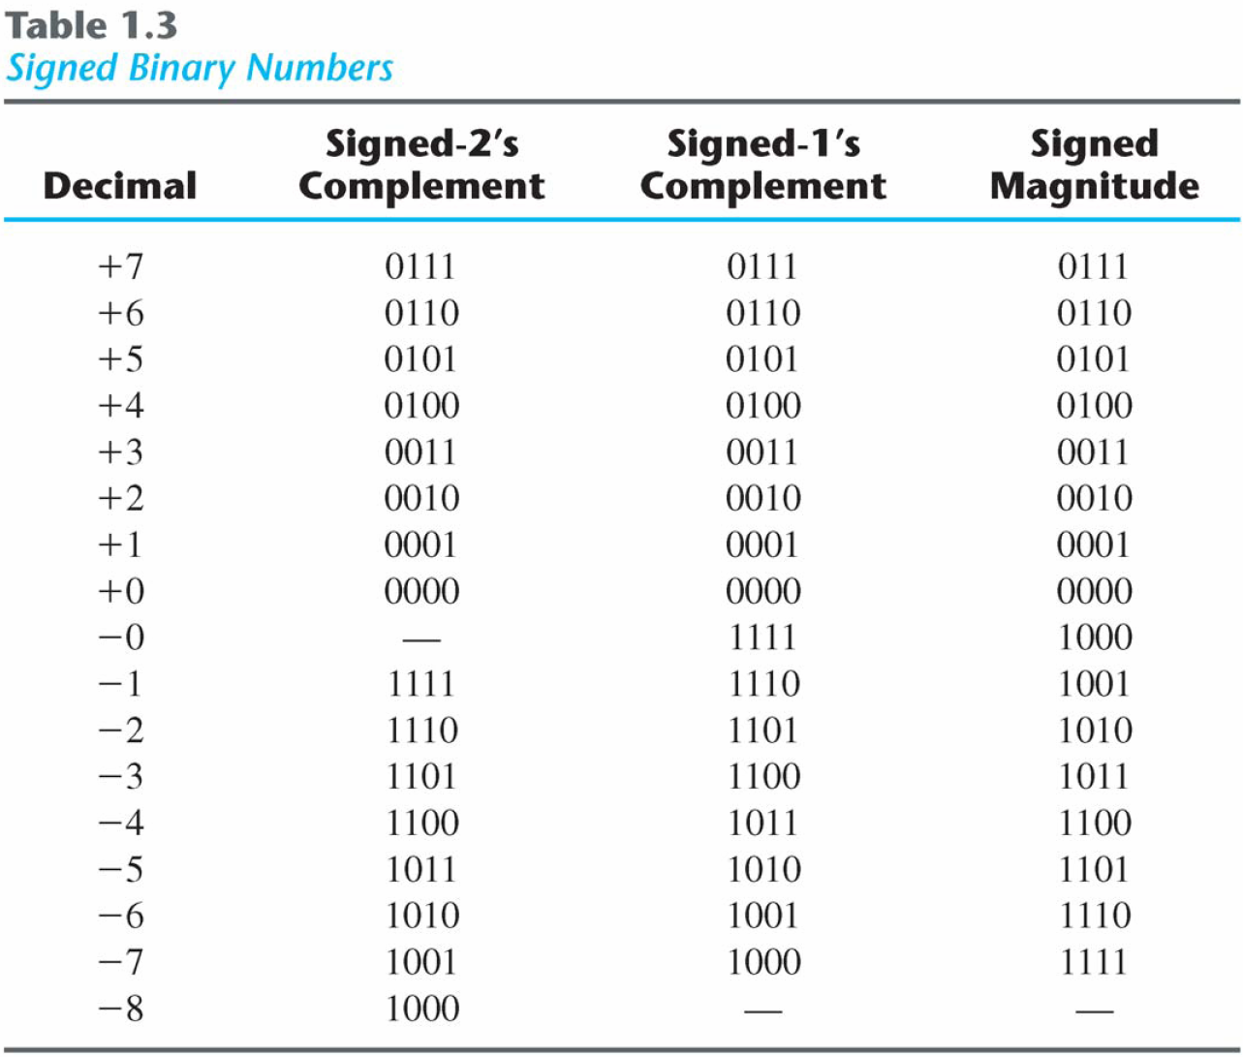
Signed Binary Numbers :

Slide 51
Binary Coded decimal : BCD
Example:
Consider decimal 185 and its corresponding value in BCD and binary:
BCD addition:

Slide 52
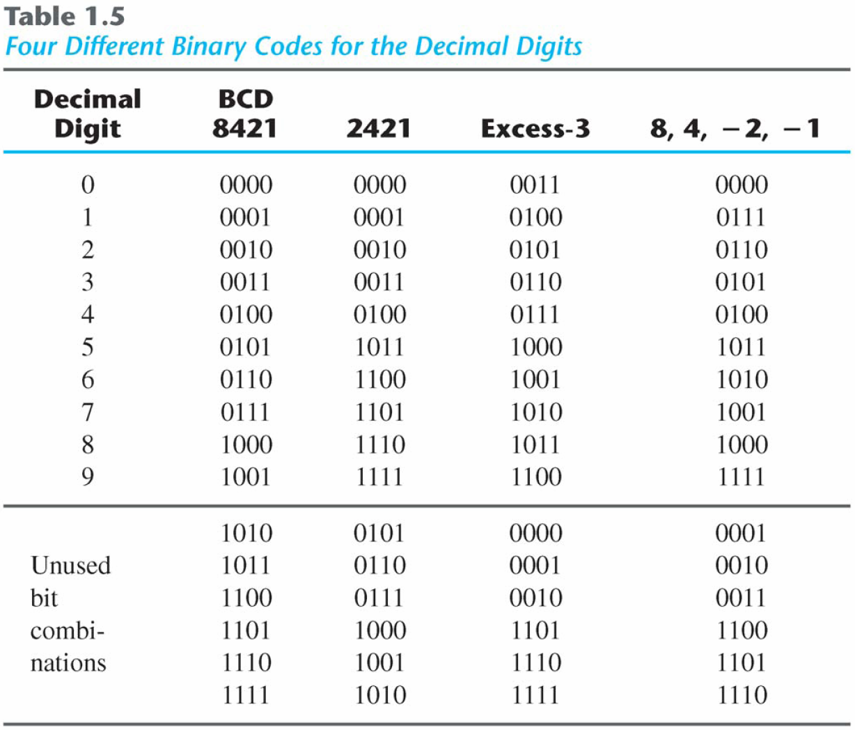
Binary Codes:
Other Decimal Codes

Slide 53
ASCII Character Codes
American Standard Code for Information Interchange (Refer to Table)
A popular code used to represent information sent as character-based data.
It uses 7-bits to represent:
94 Graphic printing characters.
34 Non-printing characters.
Some non-printing characters are used for text format (e.g. BS = Backspace, CR = carriage return).
Other non-printing characters are used for record marking and flow control (e.g. STX and ETX start and end text areas).

Slide 54
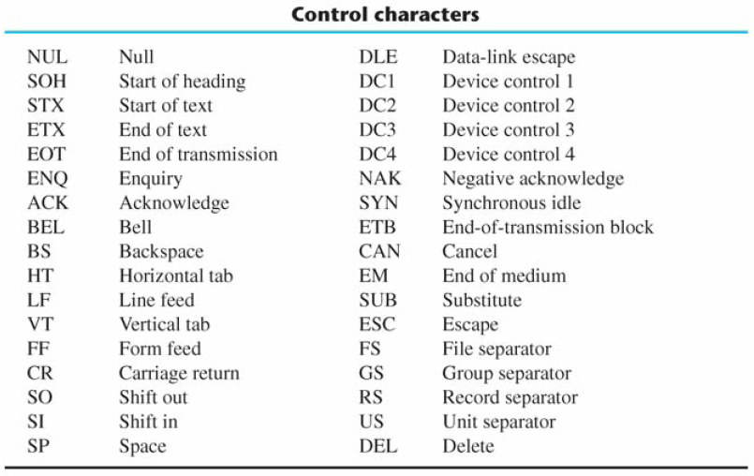
Binary Codes :
ASCII Non printing Character codes

Slide 55
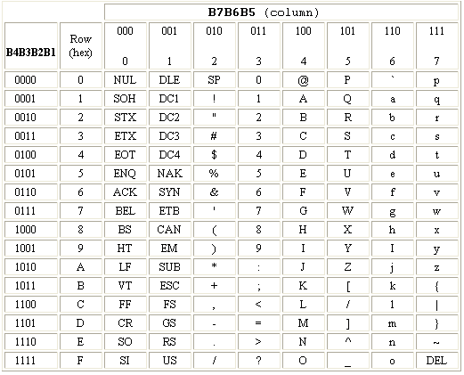
Decoding ASCII Code: B₇B₆B₅ B₄B₃B₂B₁
H=(1001000)

Slide 56
Decoders !!!

Slide 57
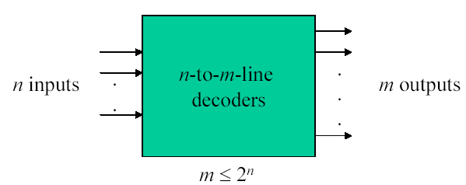
Decoder
A decoder is a combinational circuit that converts binary information from n input lines to a maximum of 2^{n} unique output lines. Only one output can be active (high) at any time
If the n-bit coded information has unused combinations, the decoder has fewer than 2^{n} outputs

Slide 58
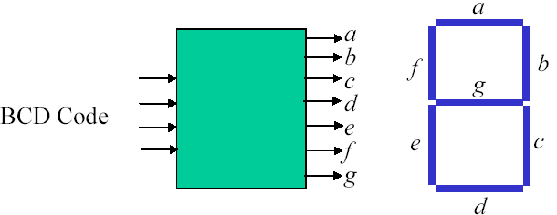
Decoder Example (Code Converter)
BCD-to-seven-segment display converter
Fig. BCD to seven segment decoder

Slide 59
Decoders
Extract “Information” from the code
Binary Decoder
Example: 2-bit Binary Number
Only one lamp will turn on
0
1
2
3
Binary Decoder
1
0
0
0
x₁
x₀
0
0

Slide 60
Decoders
2-to-4 Line Decoder
Binary Decoder
y₃
y₂
y₁
y₀
I₁
I₀
I₁ I₀ | Y₃ Y₂ Y₁ Y₀
0 0 | 0 0 0 1
0 1 | 0 0 1 0
1 0 | 0 1 0 0
1 1 | 1 0 0 0

Slide 61
Decoders
“Enable” Control
Binary Decoder
Y₃
Y₂
Y₁
Y₀
I₁
I₀
E
E | I₁ I₀ | Y₃ Y₂ Y₁ Y₀
0 | x x | 0 0 0 0
1 | 0 0 | 0 0 0 1
1 | 0 1 | 0 0 1 0
1 | 1 0 | 0 1 0 0
1 | 1 1 | 1 0 0 0
Active High

Slide 62
Decoders
3-to-8 Line Decoder
Binary Decoder
Y₇
Y₆
Y₅
Y₄ Y₃
Y₂
Y₁
Y₀
I₂
I₁
I₀

Slide 63
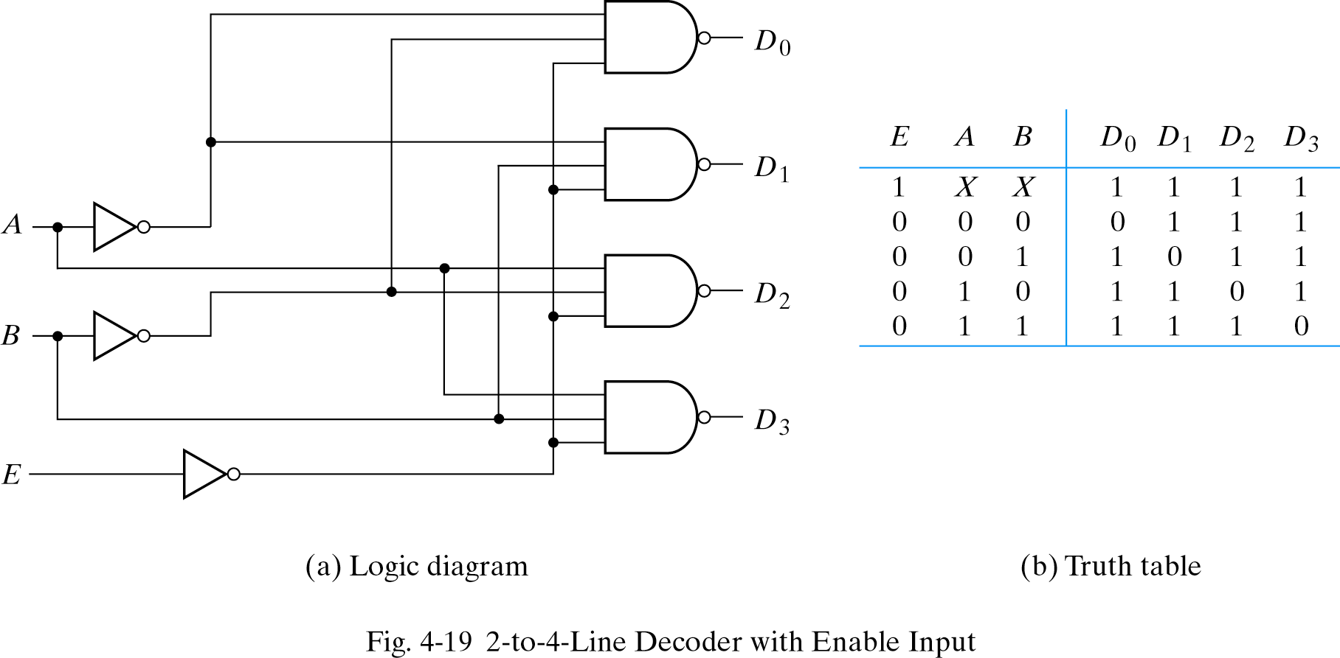
Decoders with NAND gates

Slide 64
Summary : Decoders
Active-High / Active-Low
I₁ I₀ | Y₃ Y₂ Y₁ Y₀
0 0 | 0 0 0 1
0 1 | 0 0 1 0
1 0 | 0 1 0 0
1 1 | 1 0 0 0
I₁ I₀ | Y₃ Y₂ Y₁ Y₀
0 0 | 1 1 1 0
0 1 | 1 1 0 1
1 0 | 1 0 1 1
1 1 | 0 1 1 1
Binary Decoder
Binary Decoder
Y₃
Y₂
Y₁
Y₀
Y₃
Y₂
Y₁
Y₀
I₁
I₀
I₁
I₀

Slide 65
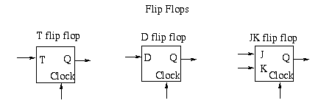
Storage elements : FF’s
The most commonly used are:
JK flip flops
T flip flops
D flip flops

Slide 66
Registers & Counters
Register
A register is a group of flip-flops, each flip flop capable of storing one bit of information.
An n-bit register consist of a group of n flip-flops capable of storing n bits of binary information.
Special function registers : Extra logic / data path
Counter
A counter is a special type of register that goes through a predetermined sequence of states.
Synchronous / asynchronous
Up / Down counter

Slide 67
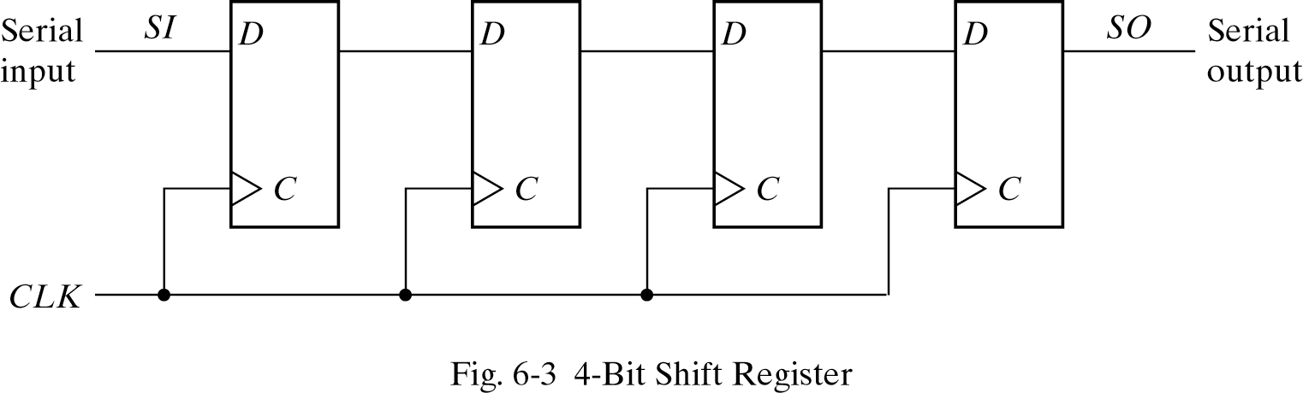
Shift Registers
A Shift register is a register capable of shifting its binary information in one or both directions.
Shift left
Shift Right
1
0
1
1
0
1
1
0
1
1

